Slide 1
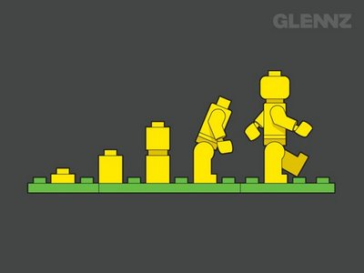
Patterns of Evolution 2
Essential Questions:
1. What are the mechanisms that lead to evolutionary change over time?
2. How do different species evolve?
3. Does evolutionary change occur in our lifetime?

Slide 2
B. Speciation
I. How do we define species?
II. Isolation
Geographic isolation
Reproductive isolation
Temporal isolation
III. Types of Speciation
Adaptive radiation
Divergent evolution
Convergent evolution

Slide 3
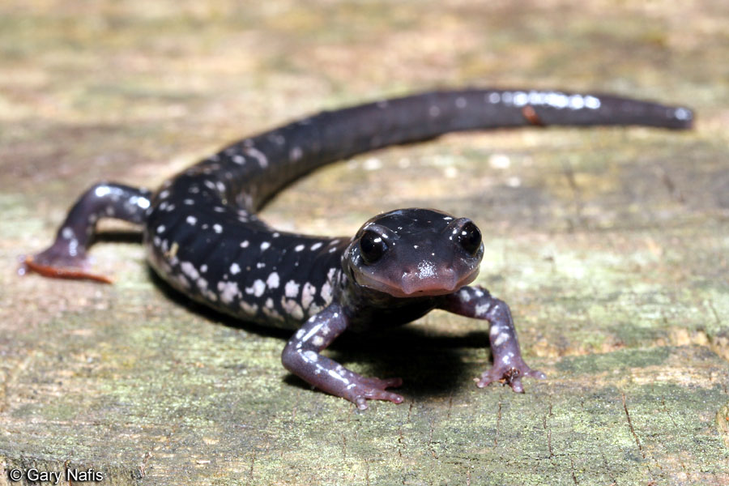
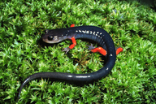
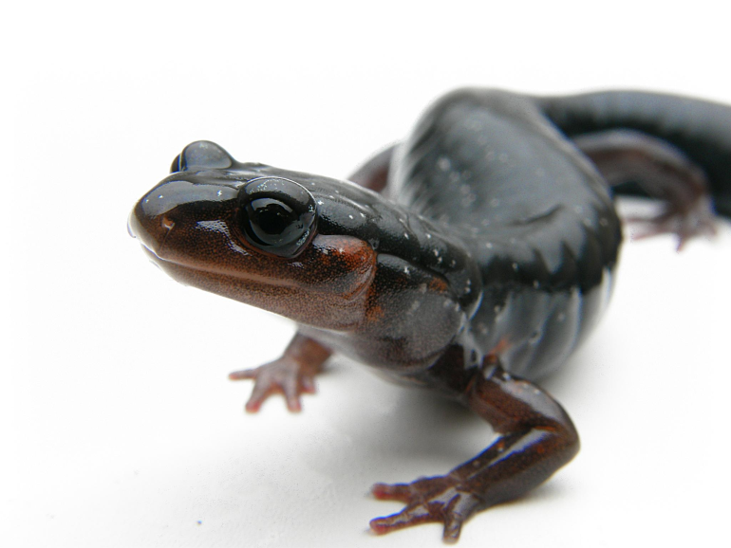
I. How do we define species?
Please note:
“1 moose, 2 moose, 3 moose”
“1 species, 2 species, 3 species”
What makes a moose a moose?
What makes a snake a snake?
What makes one salamander different
from another salamander?

Slide 4
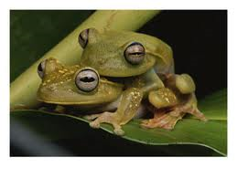
I. How do we define species?
What makes one species different from another?
I THINK:
Biological species concept
Why do we care?
I THINK:

Slide 5
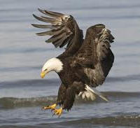
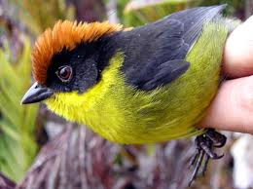
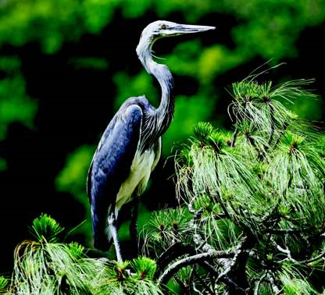
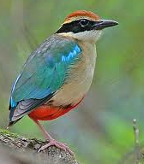
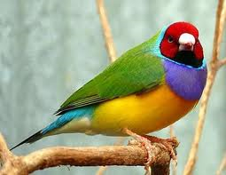
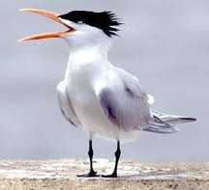
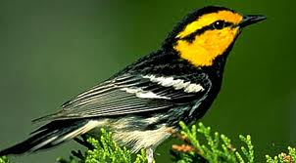
What causes speciation?
How does one species
become two species?
How is there such immense diversity of life on earth?

Slide 6
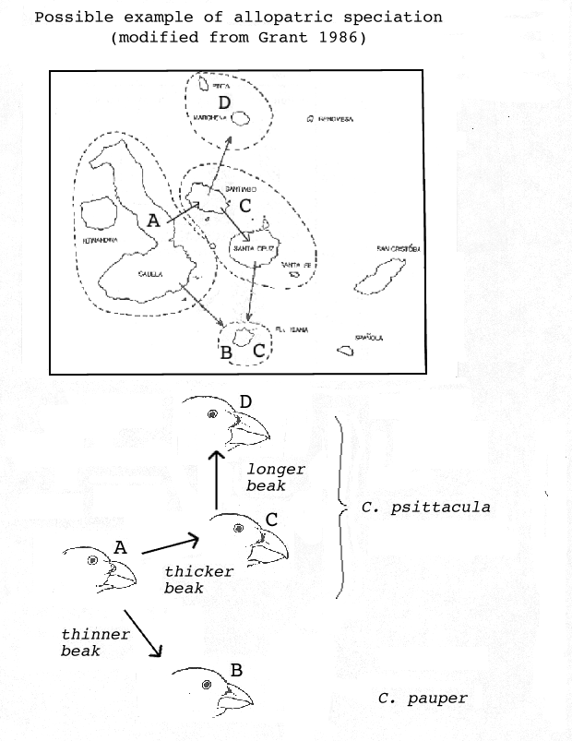
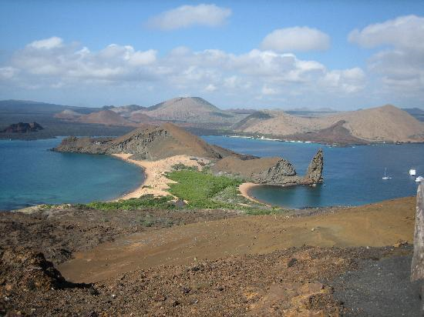
II. Isolation 1. Geographic Isolation
Dispersal across a barrier or geographical distance
Example: Galapagos finches

Slide 7
II. Isolation 1. Geographic Isolation
What are some other examples of physical barriers or distances that could separate species?
I THINK:

Slide 8
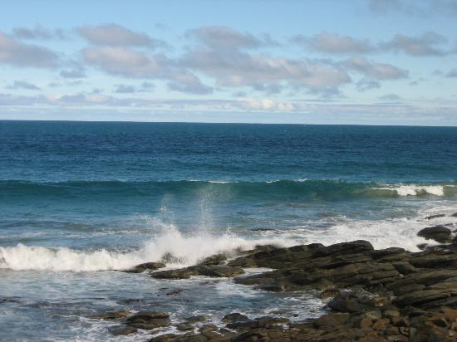
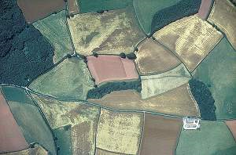
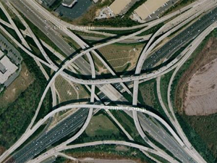
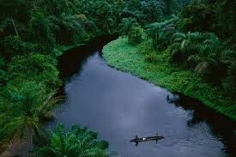
II. Isolation 1. Geographic Isolation

Slide 9
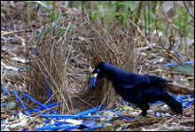
II. Isolation 2. Reproductive Isolation
1. Different mating rituals
Examples: bird songs,
firefly light displays, bowerbirds!

Slide 10
II. Isolation 2. Reproductive Isolation
1. Different mating rituals
Examples: bird songs,
firefly light displays, bowerbirds!
2. Different sexual organs
Example: damselfly penises

Slide 11
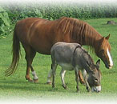
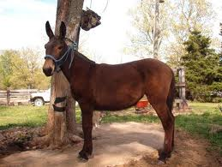
II. Isolation 2. Reproductive Isolation
1. Different mating rituals
Example: bird songs,
firefly light displays, bowerbirds!
2. Different sexual organs
Example: damselfly penises
3. Inviable (sterile) offspring
Example: mules

Slide 12
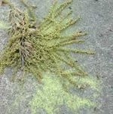
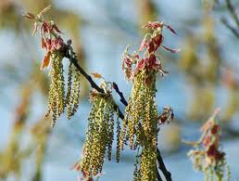
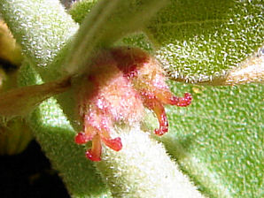
II. Isolation 3. Temporal Isolation
Different breeding “schedules”
Example: flowering

Slide 13
Putting the pieces together… (story time)

Slide 14
Fruit flies doing their thing …laying eggs in rotting bananas

Slide 15
Oh no! A hurricane washes the bananas away to an island too far to fly to. All the momma and poppa fruit flies drown, but the eggs are safely nestled inside the mushy banana

Slide 16
The fruit flies hatch on the new island and develop and reproduce in a habitat where different selective pressures and different random events take place than on the mainland.
Over time and through multiple generations,
the new fruit fly population develops different
morphology, food preference, and mating rituals.

Slide 17
Generations later, when another hurricane sends a bunch of bananas full of fly larvae from the island back to the mainland, the flies do not respond to each other’s mating rituals and do not mate. Suppose they did mate – if they had truly diverged into two different species, what would you expect to happen?
This story is an example of one species diverging to become two species

Slide 18
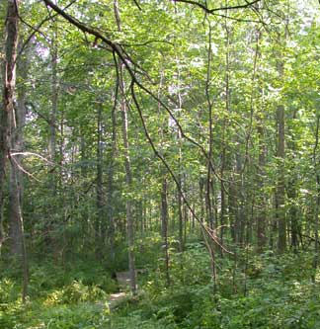
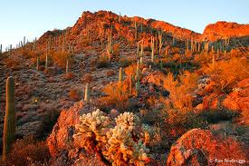
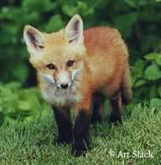
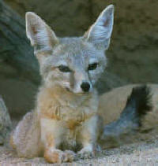
III. Types of Speciation 1. Divergent Evolution
Divergent evolution: speciation occurs due to geographic, reproductive, and/or temporal isolation to form two or more distinct species
Example: red fox and kit fox

Slide 19
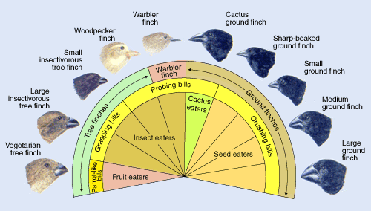
III. Types of Speciation 2. Adaptive Radiation
Adaptive radiation: Populations adapt to specific selectional pressures, allowing them to disperse and inhabit diverse habitats.
Example: Galapagos finches

Slide 20
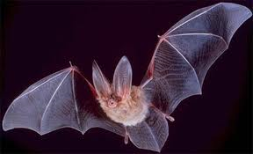
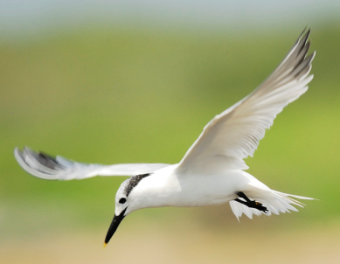
III. Types of Speciation 3. Convergent Evolution
Convergent evolution: Species that do not share recent common ancestry adapt to separate but similar selectional pressures and develop similar adaptations.
Example: Birds and bats → analogous structures!

Slide 21
C. Coevolution
Coevolution: Two or more species affect each other’s evolution.
It’s a vicious (or lovely) cycle!
Ecological relationships:

Slide 22
C. Coevolution
Coevolution: Two or more species affect each other’s evolution.
It’s a vicious (or lovely) cycle!
Ecological relationships:
Predator/prey – Competetive
Parasite/host – Mutualistic
Can you think of some possible examples of coevolution?
What is an example of coevolution between predator and prey?

Slide 23
C. Coevolution
Coevolution: Two or more species affect each other’s evolution.
It’s a vicious (or lovely) cycle!
Ecological relationships:
Predator/prey – Competetive
Parasite/host – Mutualistic
Can you think of some possible examples of coevolution?
What is an example of coevolution between predator and prey?
What is an example of coevolution between competitors?

Slide 24
C. Coevolution
Coevolution: Two or more species affect each other’s evolution.
It’s a vicious (or lovely) cycle!
Ecological relationships:
Predator/prey – Competetive
Parasite/host – Mutualistic
Can you think of some possible examples of coevolution?
What is an example of coevolution between predator and prey?
What is an example of coevolution between competitors?
What is an example of coevolution between parasite and host?

Slide 25
C. Coevolution
Coevolution: Two or more species affect each other’s evolution.
It’s a vicious (or lovely) cycle!
Ecological relationships:
Predator/prey – Competetive
Parasite/host – Mutualistic
Can you think of some possible examples of coevolution?
What is an example of coevolution between predator and prey?
What is an example of coevolution between competitors?
What is an example of coevolution between parasite and host?
What is an example of coevolution between mutualistic species?

Slide 26
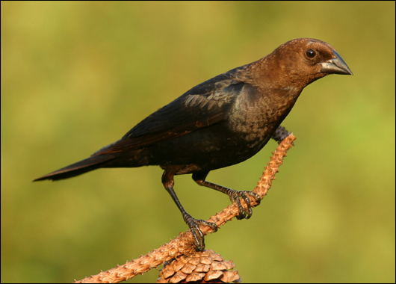
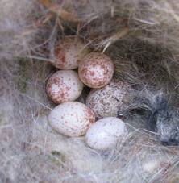
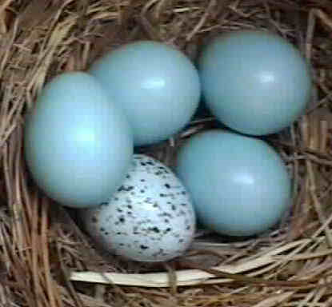
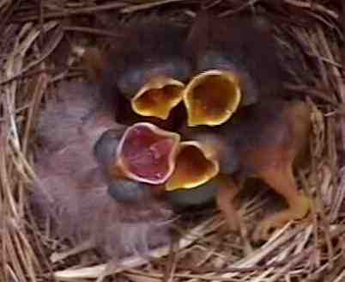
C. Coevolution
Coevolution: Two or more species affect each other’s evolution.
It’s a vicious (or lovely) cycle!
Ecological relationships:
Predator/prey – Competetive
Parasite/host – Mutualistic
Example: brood parasitism – cowbirds!

